Slide 1
Garner Health Case Study
Examination of Engagement
Daron Marino

Slide 2
Overview and Takeaways
Clients
Engagement Funnel
User Segmentation/Specialties
Engagement varies greatly between clients. This is largely based on the number of registered users per client
Client engagement also varies over time
Emphasis on creating accounts and recommendations (steps 2 and 3)
This will affect step 5 and result in more engagement via submitted claims.
Potential for A/B testing recommender systems
Segmentation by sex and family status
Focus on Primary Care services and Mental Health care

Slide 3
Summary of the Data
Mean Claim Amount | $1939.96
Median Claim Amount | $211.00
Conversion Rate (eligibility to user) | ~42.8%
Client A User Count | 45
Client B User Count | 136
Client C User Count | 471
Client D User Count | 69
Client E User Count | 210
Client F User Count | 276
The claim amount data are highly positively skewed as evidenced by the differences in mean and median amounts

Slide 4
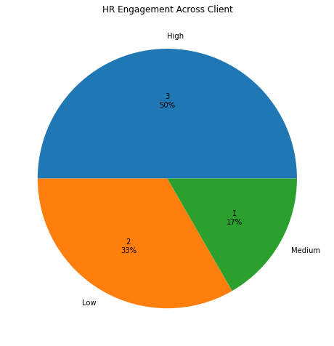
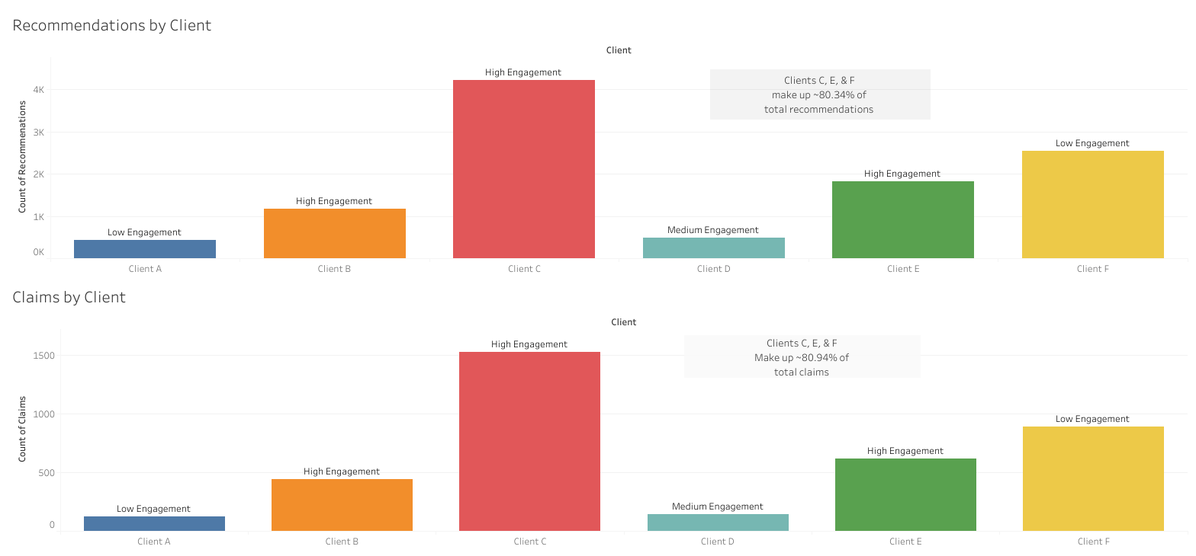
Client Engagement
An initial look at HR Engagement shows the majority of clients have high HR engagement
But HR engagement doesn’t translate perfectly to user engagement
Notes:
Some clients have far more eligible employees and resultantly, more users who sign up for the benefit.

Slide 5
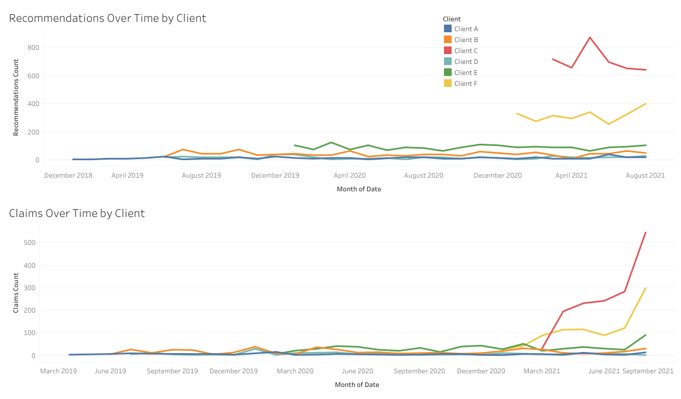
Client Engagement
Client engagement also changes over time.
Client C is seeing decreased engagement via recommendations over time but an increase in claims over time, signalling repeated visits to physicians
Overall, claims are increasing over time

Slide 6
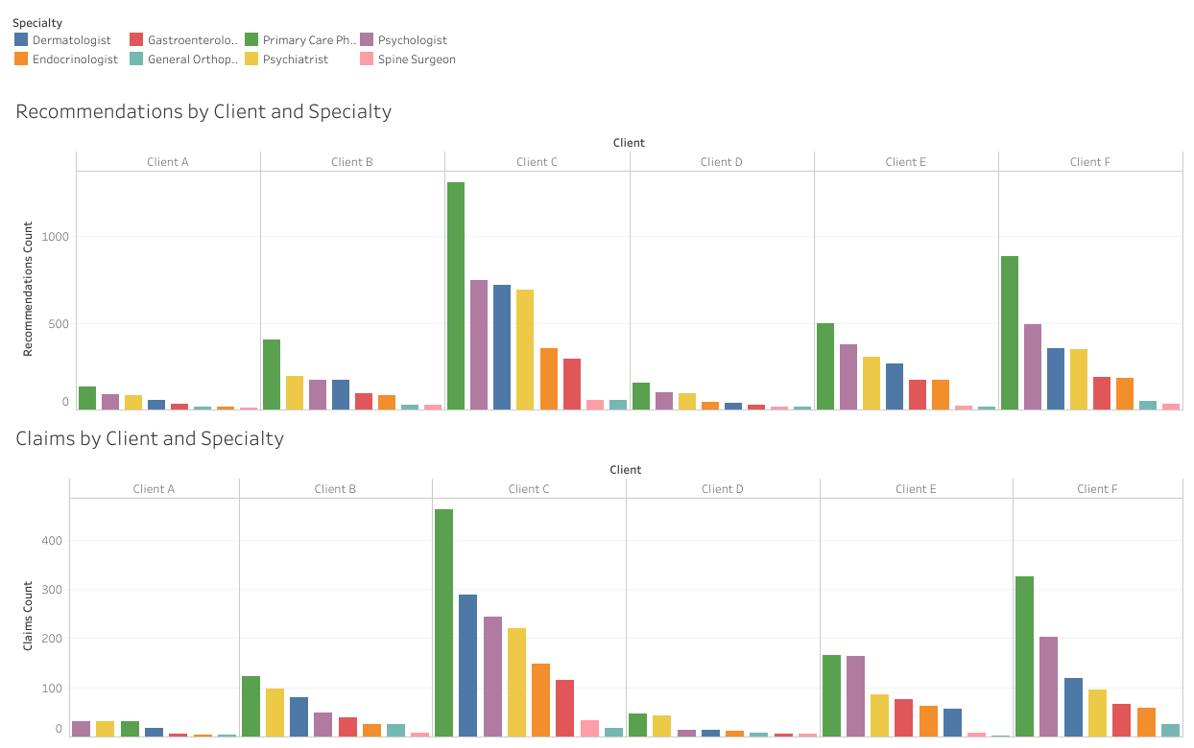
Client Engagement by Specialty
Users receiving both recommendations and claims follow a similar pattern across Client
Clients C, E, and F all have higher user engagement, but this can be attributed to more users and likely larger companies

Slide 7
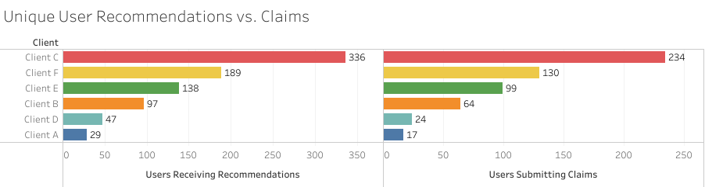
Engagement Funnel
~57.2% of the observed eligible employees are not signing up for an account via the Garner Health platform.
2820 vs 1207
Similarly, only ~68% of observed users who are receiving recommendations are also seeing a healthcare provider and submitting claims
Focusing on both steps 2 (account creation) and 3 (recommendations) will encourage more engagement with the platform via both more users and claims submitted

Slide 8
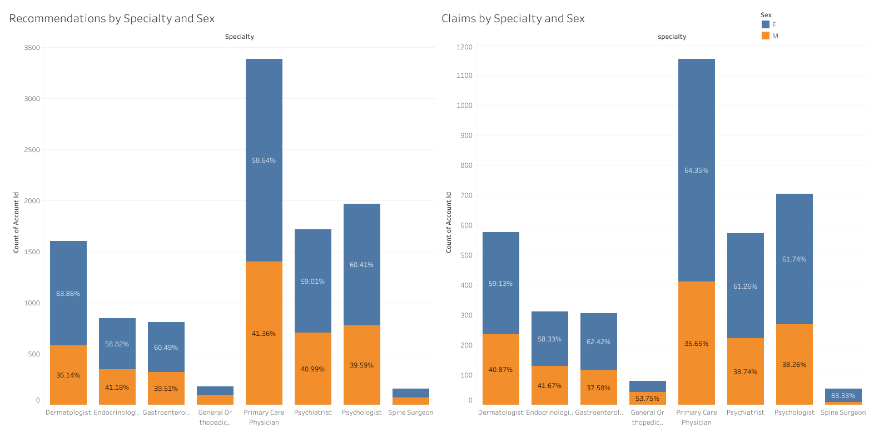
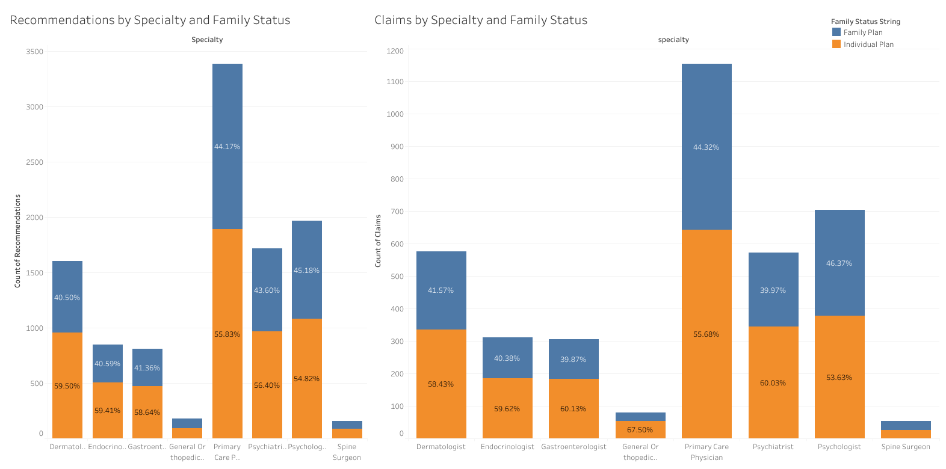
User Segmentation by Sex and Family Status
Users seem to be seeking and receiving care differently based on their Sex and Family Status.
Users on individual plans are seeking and receiving care more often than users on family plans.
This is likely because there are more users on individual plans (676) than family plans (531) signed up for the benefit.
Female users are seeking and receiving care more often than Male users.
Similarly, this is likely because there are more Female users (707) than Male users (500).

Slide 9
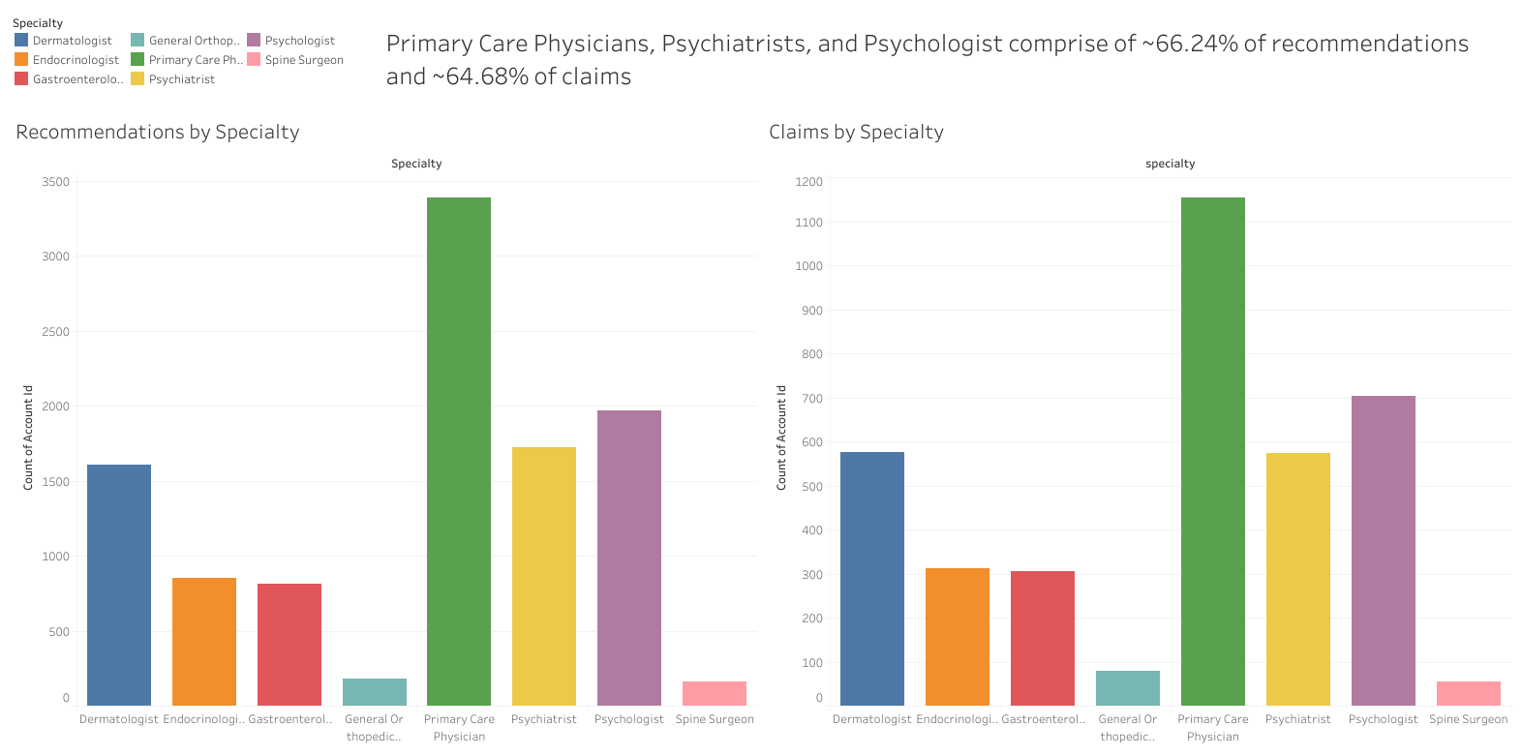
Specialties to Focus On: Primary Care and Mental Health (MH) Services
Not only do Primary Care and MH services represent the majority of both recommendations and claims, but these specialties develop long-term, clinical relationships with their clients, encouraging more engagement with Garner via submitted claims
People receiving MH services often shop around until they find the correct fit
Resultantly, this will also encourage more engagement via both recommendations and claims
Notes:
Primary care physicians are also often the referral source for other specialties

Slide 10
Thank You! Any Questions?
email: marino.daron@gmail.com
GitHub Repo
LinkedIn

